Slide 1
CS 589 Fall 2021
Text Mining and Information Retrieval
Monday 6:30-9:00
Babbio 122
All zoom links in Canvas
photo: https://www.scubedstudios.com/information-retrieval/
Notes:
Hi everyone, welcome to CS589, I’m your instructor, Susan Liu.
Our weekly meeting for this course will be on Mondays.

Slide 2
Instructor: Susan Liu
TA: Guanqun Yang
xliu127@stevens.edu gyang16@stevens.edu
OH: Tuesday 3-5 Friday 3-5
Notes:
A little bit about the crews here, my name Susan Liu, an assistant professor in the Computer Science department, my research interest is on NLP, text mining and information retrieval, and their applications to software engineering and security.
How many people here cannot attend my office hour?

Slide 3
CS589 Lecture 1: Overview
Logistics
COVID requirement
Pre-requisite
Final grade calculation
Q & A
Lecture 1
What is information retrieval?
History of IR
Earlier IR models
TF-IDF, vector space model

Slide 4
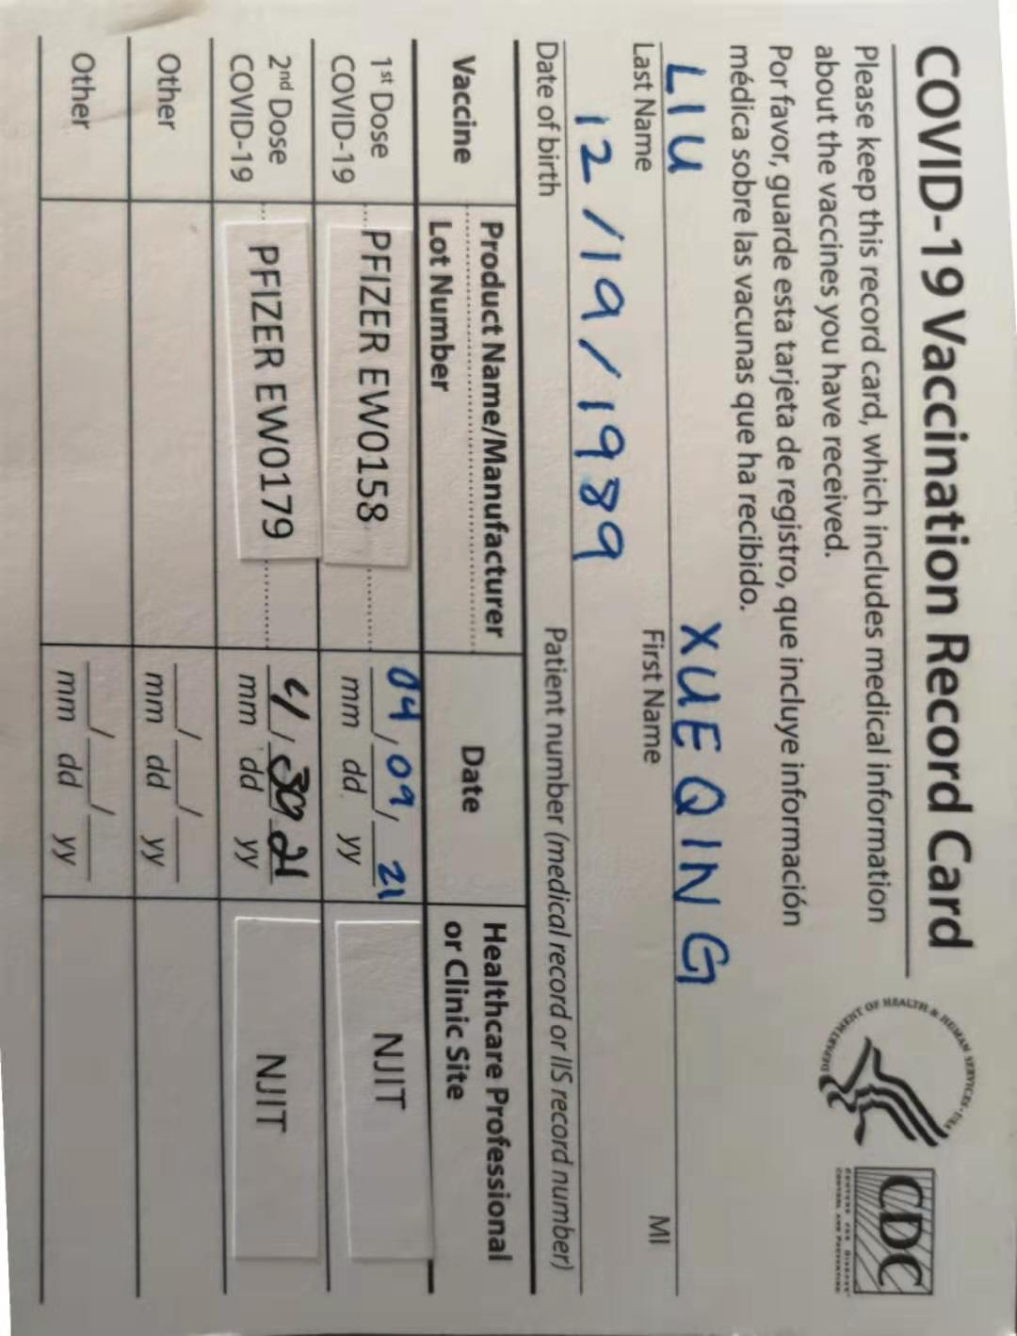
Notes:
creates the building block of more advanced techniques

Slide 5
Hybrid teaching requirements!
Mask is required in classroom
Only come to the classroom if
You are fully vaccinated
Show a negative testing result within 5 days
Notes:
creates the building block of more advanced techniques

Slide 6
Prerequisite
Recommended: A good knowledge on statistics and probability
Required: Being comfortable with Python programming (pop quiz today)
Undergrad: CS115, CS284, MA 232, MA 222
Contact the instructor if you aren’t sure
Notes:
It will be followed by a pop quiz later, don’t worry it doesn’t count in your final grade
A good knowledge on statistics and proability will always help because we will be talking about something related to probabilistic distributions, bayes theorem, maximum likelihood estimation, monte carlo methods, and it may feel a bit overwhelming if you don’t know any of these. But we will also walk you through the math background in class, so don’t worry too much if you don’t know one thing or two.
On the other hand, it is very important that Python is required. There will be 4 assignments in this class and all of them require coding in Python, so you must be quite comfortable with writing Python already. And here being comfortable with Python means when asked to implement a new algorithm in Python, you will not experience any major problems in the programming language aspect.

Slide 7
Grading calculator
4 Colab-based assignments - 40%
Midterm (in class, online) - 30%
Project (paper review, proposal, presentation, final report) - 30%
Notes:
creates the building block of more advanced techniques

Slide 8
Late policy
Submit within 24 hours of deadline - 90%, within 48 hours - 70%, 0 if code not compile
Late by over 48 hours are generally not permitted
Notes:
creates the building block of more advanced techniques

Slide 9
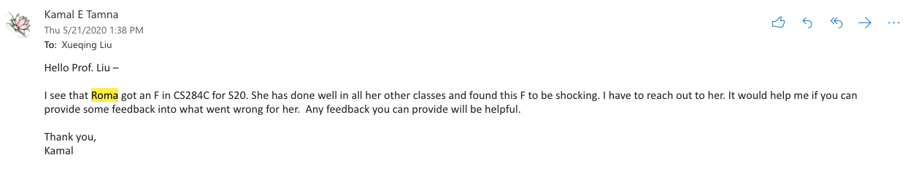
Plagiarism policy
We have a very powerful plagiarism detection system, do not take the risk
Cheating case in CS284
A student put all his homework on a GitHub public repo
In the end, we found 8+ students copied his code
Notes:
How to avoid things like this to happen?
Think twice whether you are good at Python
Start homework early
Come to office hour

Slide 10
Final Project
Week 7
Students choose a topic; for each topic, they pick 2-3 coherent papers, and submit a “peer review” for the paper
Week 11
Students who share the same interest are categorized into groups; each group propose a research topic motivated by their survey
Week 15
Deliver a presentation in Week 14
Week 16
Submit their implementation (code in Python) as well as an 8-page academic paper as their final project.
Notes:
creates the building block of more advanced techniques

Slide 11
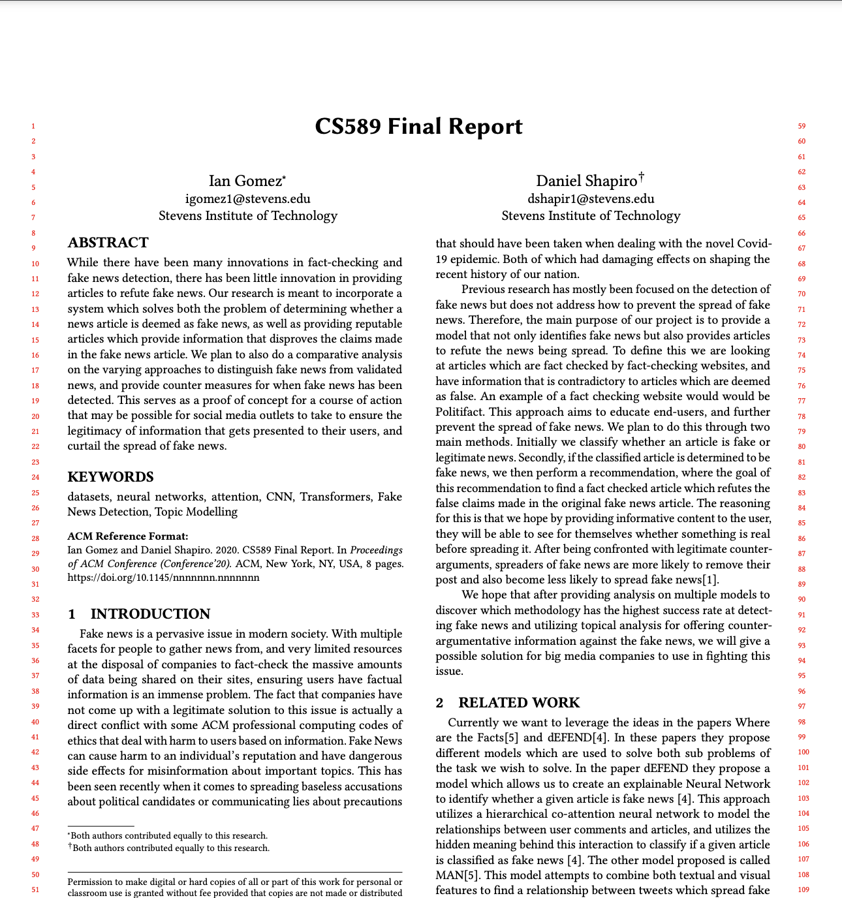
Final Project
Example report from last year’s course: fake news detection
Notes:
creates the building block of more advanced techniques

Slide 12
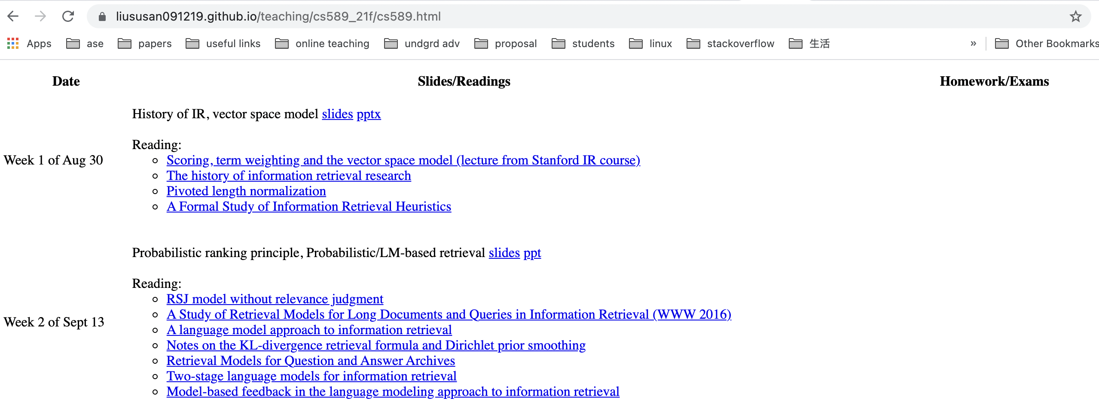
Where can I find all the information?
Notes:
creates the building block of more advanced techniques

Slide 13
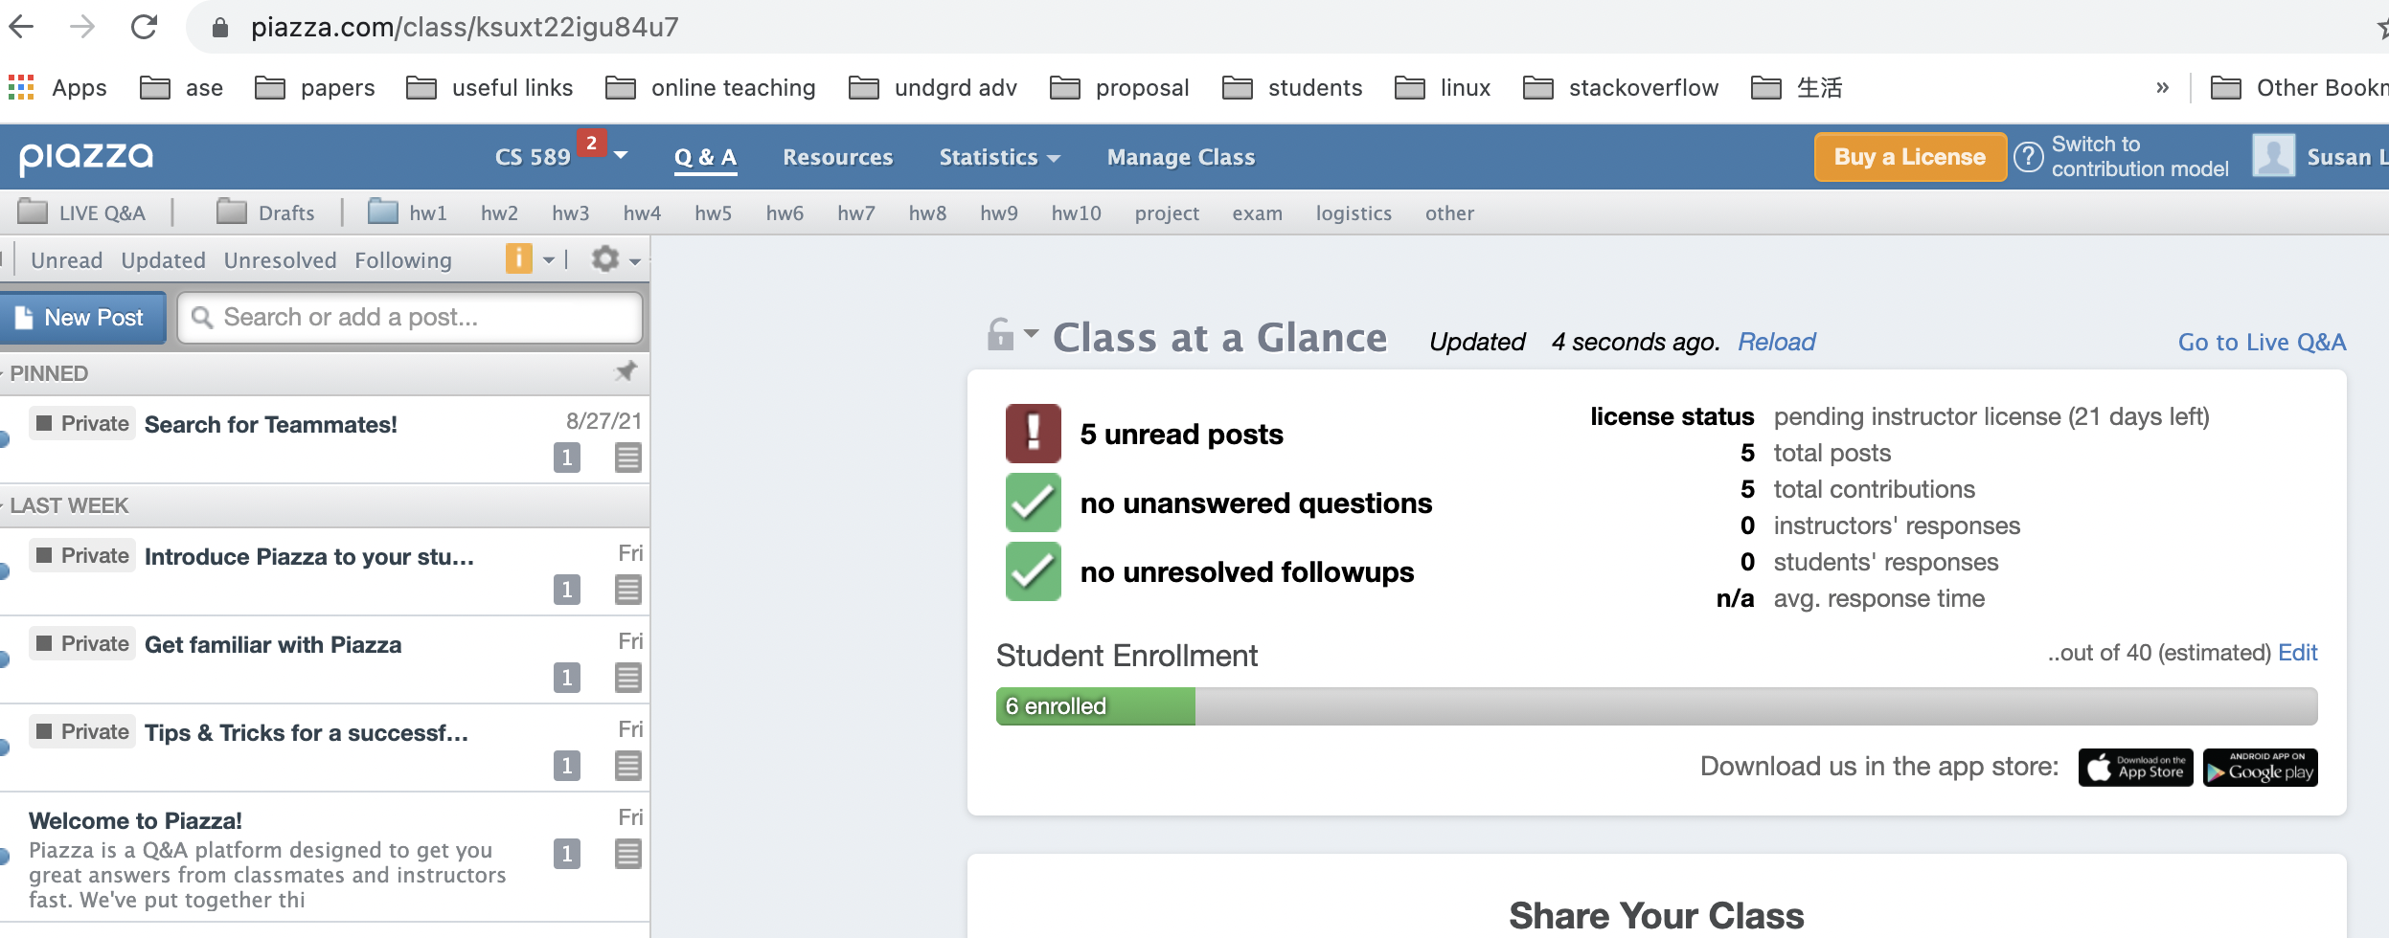
Ask ALL questions in Canvas -> Piazza
Notes:
creates the building block of more advanced techniques

Slide 14
Information Retrieval: Real life example
“I need a book on American history for my thesis research!”
Information need: to study about the history of the civil war
Notes:
You may still remember the cartoon on the first slide, that is a person tries to find the relevant document from a pile of documents
In real life, the closest scenario to information retrieval is when you walk into a library, and asking a question.
Notice the question here can be very vague, there are tens of thousands of books on that topic. So we can identify two things here:
The researcher may not be able to clearly specify the information need
The librarian’s job is to help the researcher identify a book that’s most relevant to her information need

Slide 15
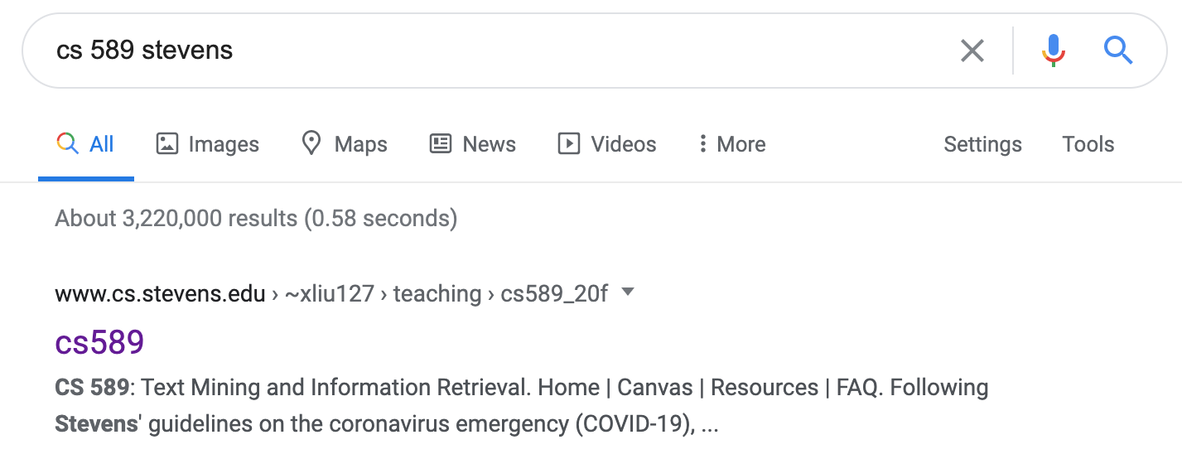
Information Retrieval: Google
How does Google know cs 589 refers to a course?
How does Google know stevens = SIT?
How does Google return results so quickly?
Notes:
Nowadays, an information retrieval system looks more like this: where the user types in a query which is very vague, but the system which plays the role of a librarian, is able to find the information that’s exactly what the user has specified even if the query is incomplete

Slide 16
Information Retrieval Techniques
“Because the systems that are accessible today are so easy to use, it is tempting to think the technology behind them is similarly straightforward to build. This review has shown that the route to creating successful IR systems required much innovation and thought over a long period of time. “
— The history of Information Retrieval Research, Mark Sanderson and Bruce Croft

Slide 17
Information Retrieval Techniques
Query understanding, personalization, results diversification, result page optimization, etc.
Making sure the results are returned to users fast
Notes:
Online shopping used to be very hard, because of the information overload, but thanks to the recommender system we can now. Now almost any website/application you visit, they can quickly adapt to your information need and know what you want immediately.

Slide 18
A Brief History of IR
1958
Cranfield evaluation methodology; word-based indexing
300 BC
1960s
building IR systems on computers; relevance feedback
Callimachus: the first library catalog
1970s
TF-IDF; probability ranking principle
1980s
TREC; learning to rank; latent semantic indexing
1950s
1990 - now
web search; supporting natural language queries;
Punch cards, searching at 600 cards/min
Notes:
creates the building block of more advanced techniques

Slide 19
The Boolean retrieval system
Notes:
You have the board where each row represents a document, and there’s this stick with flexible pins you can adjust the position of the pins, each pin represent a word. To match all the documents, you simply rotate the pins, and try plug the stick into the board

Slide 20
The Boolean retrieval system
e.g., SELECT * FROM table_computer WHERE price < $500 AND brand = “Dell”
Primary commercial retrieval system for 3 decades
Many systems today still use the boolean retrieval system, i.e., eCommerce search, etc.
Advantage: Returns exactly what you want
Disadvantage:
can only specify queries based on the pre-defined categories
two few / two many queries
Notes:
This system is called the Boolean retrieval system. In other words, you use attributes to define every item in the system, and filter based on the attributes. If you have learned SQL, this is a query you can submit to the system
One disadvantage is the user may specify a condition that does not exist

Slide 21
The Cranfield experiment (1958)
Imagine you need to help users search for literatures in a digital library, how would you design such a system?
computer science
query = “subject = AI & subject = bioinformatics”
artificial intelligence
bioinformatics
system 1: the Boolean retrieval system
On the history of IR: https://journals.sagepub.com/doi/abs/10.1177/0165551507086989?journalCode=jisb
Notes:
The Boolean system worked, but then people started thinking about improving over it.
In order to test whether the Boolean retrieval system’s performance, a person named Steven Robertson conducted an experiment called the Cranfield experiment, where he compared the Boolean retrieval system and a second system based on word indexing.

Slide 22
The Cranfield experiment (1958)
Imagine you need to help users search for literatures in a digital library, how would you design such a system?
Document-term matrix
 | intelligence | book | the | cat | artificial | dog | business
Doc1 | 0 | 1 | 3 | 1 | 0 | 1 | 0
Doc2 | 1 | 0 | 0 | 0 | 0 | 0 | 1
query | 1 | 0 | 1 | 0 | 1 | 0 | 0
artificial
query = “ the artificial intelligence”
bags of words representation
system 2: indexing documents by lists of words
Notes:
creates the building block of more advanced techniques

Slide 23
The Cranfield experiment (1958)
system 1
compare
system 2
Boolean retrieval system < word indexing system
Notes:
It is another topic of how to compare the two system, because you see the comparison is not as easy as if you want to compare two machine learning systems.

Slide 24
Word indexing: vector-space model
Represent each document/query as a vector
The similarity = cosine score between the vectors
Notes:
Now let’s talk about how the word index based system works. One of the most widely used model is called the vector space model, which is still used today. It represents each document and query as a vector, and their similarity

Slide 25
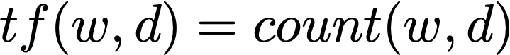
Term frequency
Document-term matrix
 | intelligence | book | the | cat | artificial | dog | business
Doc1 | 0 | 1 | 3 | 1 | 0 | 1 | 0
Doc2 | 1 | 0 | 0 | 0 | 0 | 0 | 1
query | 1 | 0 | 1 | 0 | 1 | 0 | 0
artificial
d1= “the cat, the dog, and the book”
[0, 1, 3, 1, 0, 1, 0]
d2 = “business intelligence”
[1, 0, 0, 0, 0, 0, 1]
query = “the artificial intelligence”
q = [1, 0, 1, 0, 1, 0, 0]
Notes:
creates the building block of more advanced techniques

Slide 26
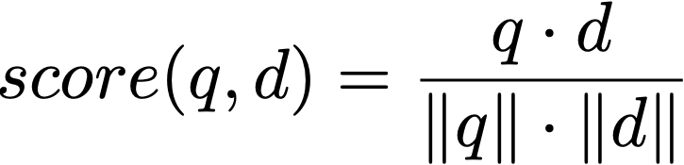
Vector space model
Document-term matrix
 | intelligence | book | the | cat | artificial | dog | business
Doc1 | 0 | 1 | 3 | 1 | 0 | 1 | 0
Doc2 | 1 | 0 | 0 | 0 | 0 | 0 | 1
query | 1 | 1 | 1 | 0 | 1 | 0 | 0
To answer the query:
“the artificial intelligence book”
q = [1, 1, 1, 0, 1, 0, 0]
d1 = [0, 1, 3, 1, 0, 1, 0]
d2 = [1, 0, 0, 0, 0, 0, 1]
Notes:
creates the building block of more advanced techniques

Slide 27
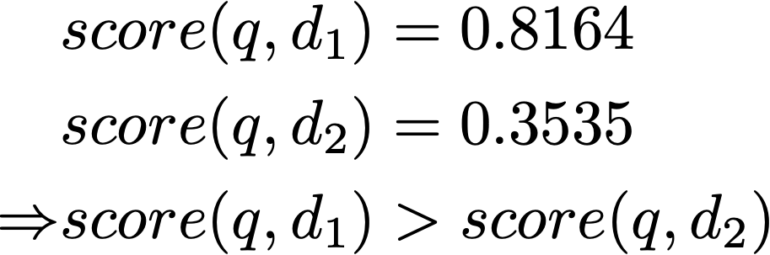
TF-only representations is inaccurate
Documents are dominated by words such as “the” “a”
These words do not carry any meanings, nor do they discriminate between documents
q = “the artificial intelligence book”
d1 = “the cat, the dog, and the book”
d2 = “business intelligence”
Notes:
creates the building block of more advanced techniques

Slide 28
Zipf’s law distribution of words
Notes:
creates the building block of more advanced techniques

Slide 29
Stop words
Documents are dominated by words such as “the” “a”
These words do not discriminate between documents
Notes:
creates the building block of more advanced techniques

Slide 30
Desiderata for a good ranking function
Rule 1: If a word appears everywhere, it should be penalized
Rule 2: If a word appears in the same document multiple times, it’s importance should not grow linearly
q = “artificial intelligence”
d1 = ““Artificial intelligence was founded as an academic discipline in 1955, and in the years since has experienced several waves of optimism”
d2 = ““Artificial intelligence was founded as an academic discipline in 1955, artificial intelligence”
d2 is not twice more relevant than d1
Notes:
creates the building block of more advanced techniques

Slide 31
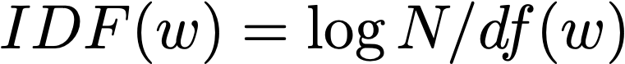
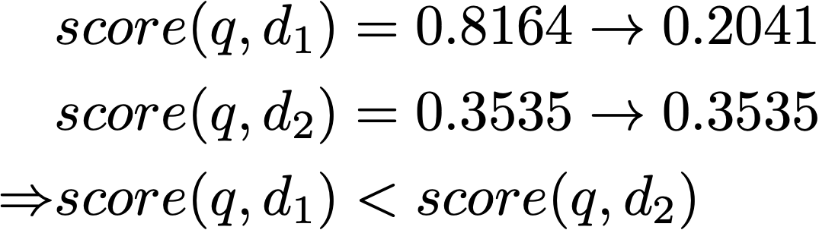
Inverse-document frequency
Inverse-document frequency: penalizing a word’s TF based on its document frequency
q = “the artificial intelligence book”
d1 = “the cat, the doc, and the book”
d2 = “business intelligence”
TF-IDF weighting
Notes:
creates the building block of more advanced techniques

Slide 32
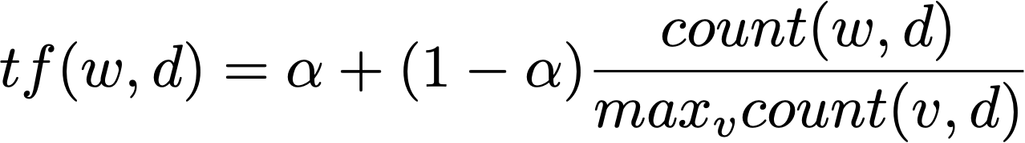
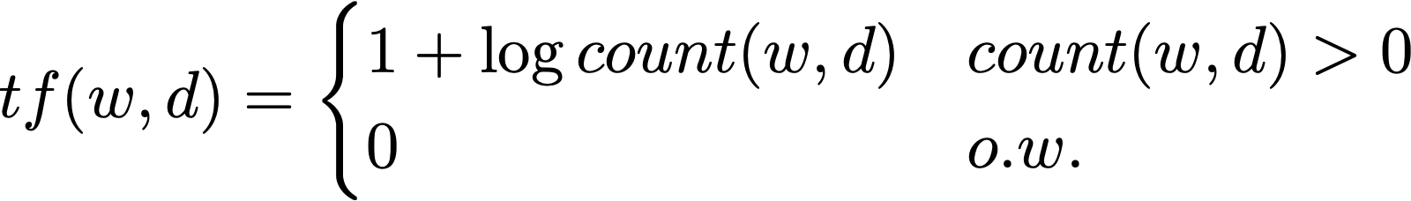
Term frequency reweighing
Term frequency reweighing: penalizing a word’s TF based on the TF itself
If a word appears in the same document multiple times, it’s importance should not grow linearly
Max TF normalization
Log scale normalization
Notes:
creates the building block of more advanced techniques

Slide 33
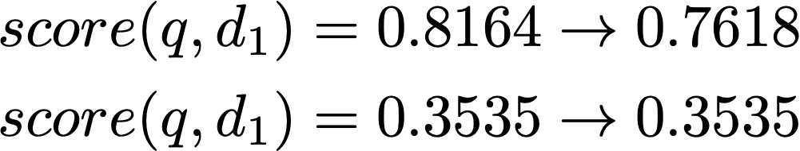
Term-frequency reweighing
Logarithmic normalization
Log scale normalization
q = “the artificial intelligence book”
d1 = “the cat, the doc, and the book”
d2 = “business intelligence”
Notes:
creates the building block of more advanced techniques

Slide 34
Retrieving short documents vs. retrieving long documents
The difference between retrieving short documents and long documents
Longer documents cover more topics, so the query may match a small subset of the vocabulary
Longer documents need to be considered differently
q = “artificial intelligence”
d1 = “artificial intelligence book”
d2 = “Artificial intelligence was founded as an academic discipline in 1955, and in the years since has experienced several waves of optimism “
Notes:
creates the building block of more advanced techniques

Slide 35
Retrieving short documents vs. retrieving long documents
The difference between retrieving short documents and long documents
Longer documents cover more topics, so the query may match a small subset of the vocabulary
Longer documents need to be considered differently
Short document
the
a
business
intelligence
Long document
ML
the
a
learn
NLP
business
bot
AI
Notes:
The vector space model favors short document, because in a long document, you are gonna end up with lots of words which are relevant but doesn’t match. If your query is “artificial intelligence”, it’s unlikely the word “artificial intelligence” will appear everywhere in the long document, so proportionally speaking, the probability of the matched words to appear will be lowered.

Slide 36
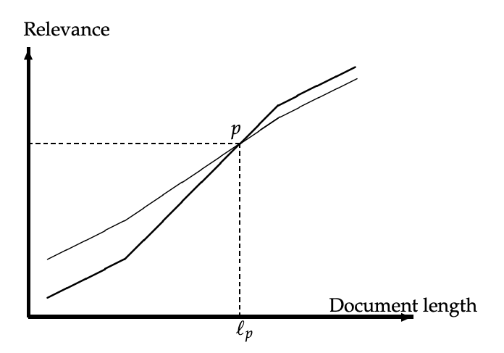
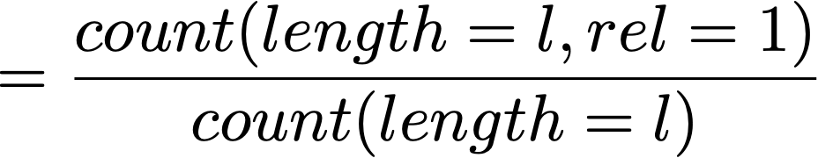
Document length pivoting
For each query q and each document d, compute their relevance score score(q, d)
Manually evaluate the relevance between q and d
relevance judg@l
relevance score
Pivoted Document Length Normalization: http://singhal.info/pivoted-dln.pdf
Notes:
creates the building block of more advanced techniques

Slide 37
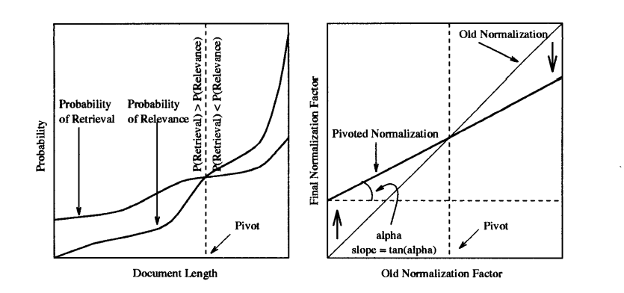

Document length pivoting
Rotate the relevance score curve, such that it most closely align with the relevance judgement curve
Pivoted Document Length Normalization: http://singhal.info/pivoted-dln.pdf
Notes:
creates the building block of more advanced techniques

Slide 38
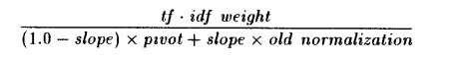
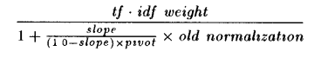
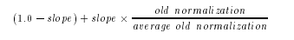
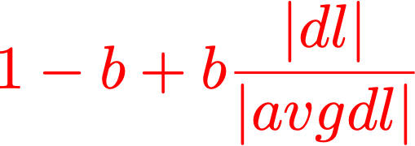
Document length pivoting
Rotate the relevance score curve, such that it most closely align with the relevance judgement curve
fixing pivot to avgdl
standard formulation for doc length normalization
Pivoted Document Length Normalization: http://singhal.info/pivoted-dln.pdf
Notes:
It’ll be nice if the pivot can be a fixed constant so we don’t have to worry about changing it.

Slide 39
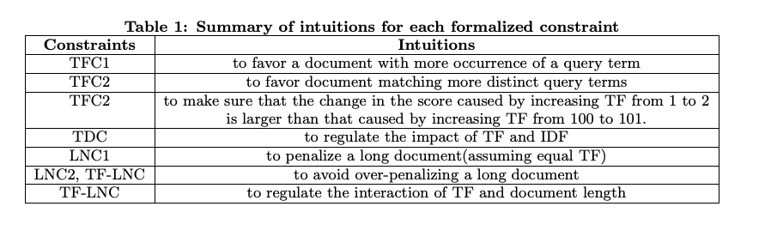
More on retrieval model design heuristics
Axiomatic thinking in information retrieval [Fang et al., SIGIR 2004]
Notes:
creates the building block of more advanced techniques

Slide 40
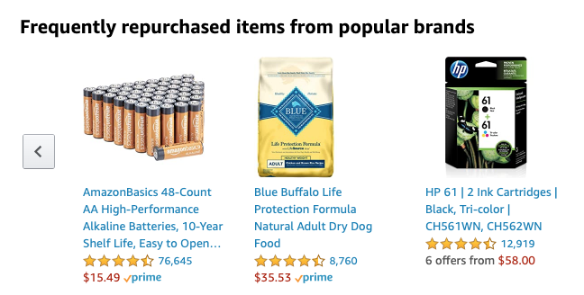
IR != web search
The other side of information retrieval techniques
Recommender systems (users who bought this also bought…)
Online advertising
Notes:
creates the building block of more advanced techniques

Slide 41
IR != web search
Factoid question answering systems
Notes:
creates the building block of more advanced techniques

Slide 42
Syllabus
Vector space model, TF-IDF
EM algorithm
RNN/LSTM
Probability ranking principle, BM25
Transformer/Bert
IR evaluation, query completion
Inverted index, ES, PageRank, HITS
Relevance feedback, PRF
Frontier topic: recommender system
Neural IR
Frontier topic: opinion analysis/mining
Frontier topic: NMT, program synthesis
Notes:
creates the building block of more advanced techniques

Slide 43
Assignment goals
Upon successful completion of this course, students should be able to:
Evaluate ranking algorithms by using information retrieval evaluation techniques, and implement text retrieval models such as TF-IDF and BM25;
Use Elastic search to implement a prototypical search engine on Twitter data;
Derive inference algorithms for the maximum likelihood estimation (MLE), implement the expectation maximization (EM) algorithm;
Use state-of-the-art tools such as LSTM/Bert for text classification tasks
Notes:
creates the building block of more advanced techniques

